Slide 1
Loan eligibility prediction
MOHANA PREYA R 312320205090
RAMYA M 312320205116

Slide 2
ABSTRACT
As the needs of people are increasing, the demand for loans in banks is also frequently getting higher every day. And finding out to whom the loan can be permitted which will be a safer option for the bank is a typical process. This system automates the loan eligibility process based on customer information. This is done by using data of the preceding records of the people to whom the loan was granted before. The machine learning approach is ideal for reducing human effort and effective decision making in the loan approval process by implementing machine learning tools that use classification algorithms to predict eligible loan applicant. In this project we are predicting the loan data by using some machine learning algorithms that is Random Forest classifier, Decision tree classifier, Logistic Regression. The primary aim of this project is to determine whether the person is eligible for loan or not.

Slide 3
INTRODUCTION
Loan Distribution is the main business part of many banks. The main portion of banks income comes from the loan distributed to customers. These banks apply interest on loan which are distributed to customers. It is an essential process for the banks to determine whether an applicant is qualified to receive a loan. This process involves assessing the creditworthiness of an applicant by evaluating various factors such as credit score, income, employment history, and other financial indicators. The traditional loan eligibility prediction process is manual and time-consuming, which can lead to delays in loan approval decisions. The system can provide accurate results for the n number of people. The main purpose of this project is to provide immediate results for the approval of loan to the eligible customers. With the advent of machine learning techniques, it is now possible to automate the loan eligibility prediction process, which enables financial institutions to make faster and more accurate decisions. In this project we are predicting the loan data by using some machine learning algorithms that is Random Forest classifier, Decision tree classifier, Logistic Regression. This project will discuss the limitations and future research directions of the loan eligibility prediction model to help the individual and researchers improve their loan eligibility prediction models.

Slide 4
SCOPE
The scope of Loan Eligibility Prediction is to accurately predict whether a customer is eligible for a loan based on their demographic and financial information. The project basically starts with a web-based application which acts as a interface between the user and our training model. The system is designed in such a way that the input will be taken from the user by a form and that data will be used for training our model. The model is designed with the help of logistic regression, Random Forest classifier, decision tree classifier which provides better efficiency in training the model as well as is easy to implement. Overall, the scope of loan eligibility prediction is quite broad and extends to various domains where the eligibility of individuals for loans or financial assistance needs to be assessed accurately and efficiently.

Slide 5
EXISTING SYSTEM
Till now loans are processed by various banks through pen and paperwork. When the large no of customers’ apply for bank loan these bank take lot of time to approve their loan. After approval of loan by the banks, there is no surety that the chosen applicant is capable of paying loan or not. Many banks use their own software’s for the loan approval. In existing system we use data mining algorithms for the loan approval; this is the old technique for the approval of loan. Mutiple data sets are combined and form a Generalised datasets, and different machine learning algorithms are applied to generate results. But these techniques are not up to the mark. Due to this huge banks are suffering from financial crises. To resolve this issue we introduce a new way for approval of loans.

Slide 6
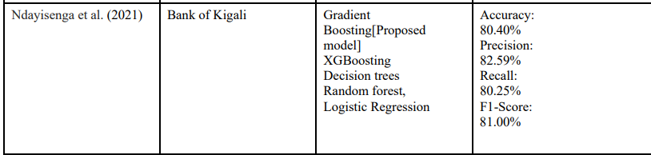
Literature Survey
Ndayisenga et al. (2021) He divided the datasets into two categories training and test, with the training dataset accounting for 70% of the total and the test dataset accounting for 30%. Ensembles were utilized to discover the best machine learning strategies to apply for predicting bank loan default. Gradient Boosting (Accuracy 80.40 %) was shown to be the best model for predicting bank loan default, followed by XGBoosting, with decision trees, random forest, and logistic regression performing badly.

Slide 7
Mohammad et. al (2020) proposed a study to predict whether or not a bank would give a loan to a customer. The goal of the model was to achieve classification; hence using Logistic Regression with sigmoid function was used for developing the model. The dataset for studying and prediction was obtained from Kaggle and consisted of two data sets, one for training and the other for testing. The model produced an accuracy of 81%, according to the final results As a result, by calculating the chance of default on a loan, the suitable customers to target for loan giving might be simply identified using a logistic regression approach.

Slide 8

Pidikitiet al.( 2019) designed an effective model, the major goal of this paper was to lower the risk element associated with picking a safe individual to assign the loan in order to save time and money for the bank. There were four sections to this paper. (i) Data collection (ii) Machine learning model comparison using the data acquired (iii) System training using the most promising model (iv) Testing. They forecasted loan data using machine learning algorithms such as classification, logistic regression, Decision Tree, and gradient boosting in this paper. When compared to other algorithms, the decision tree method was found to be the most accurate, with an accuracy of 82 percent. It was successful because it produced improved results in classification problem.

Slide 9
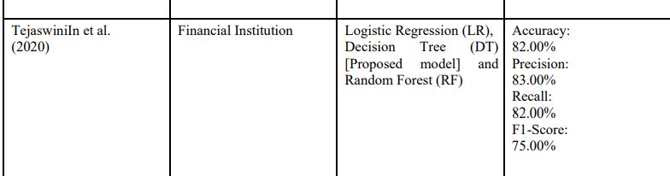
In Tejaswini et al. (2020) a robust predictive modeling method was presented to approve or reject loan applications based on the customers' historical financial and credit scores.. Every new applicant's information entered on the application form serves as a test data set. In this paper, they used three machine learning methods to predict client loan approval: Logistic Regression (LR), Decision Tree (DT), and Random Forest (RF). The testing results show that the Decision Tree machine learning algorithm hasa higher accuracy of 82.00 % when compared to Logistic Regression and Random Forest machine learning techniques

Slide 10
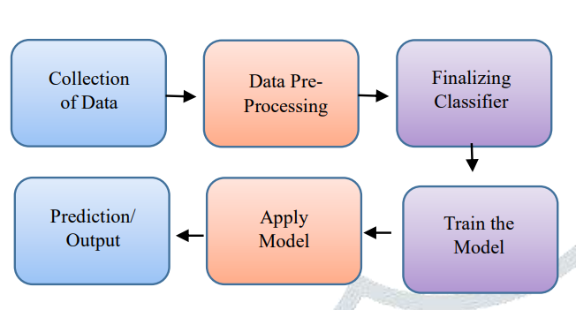
SYSTEM ARCHITECTURE

Slide 11
ARCHITECTURE DESCRIPTION
The figures show the flow of the loan prediction system. Firstly we developed a web application that acts as a bridge between the user and our training model. All data we get from a web application that act as input to data processing in that we perform data completion In the data completion there are often missing values in the dataset due to improper data entry or other data entry problems that can lead to issues in data analysis, thereby affecting the accuracy of the system and after the preprocessing and testing operation, the system will guess whether the new applicant is a fit case for approval of the loan or not based upon the algorithm. it concludes on the basis of the training data sets

Slide 12
REQUIREMENTS SPECIFICATION
OS: Windows or Linux
PYTHON IDE: python 3.11.2.
PYCHARM IDE
JUPYTER NOTEBOOK
HTML 5
CSS
JAVASCRPIT
.

Slide 13
LIBRARIES USED
NUMPY
PANDAS
SKLEARN
MATPLOTLIB
FLASK
SEABORN

Slide 14
METRICES
Accuracy
F1 Score
Precision
Recall

Slide 15
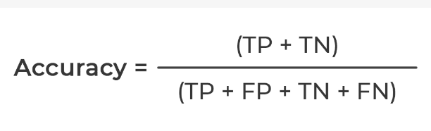
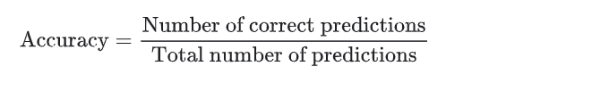
Accuracy
Accuracy can also be defined as the ratio of the number of correctly classified cases to the total of cases under evaluation. The best value of accuracy is 1 and the worst value is 0.

Slide 16
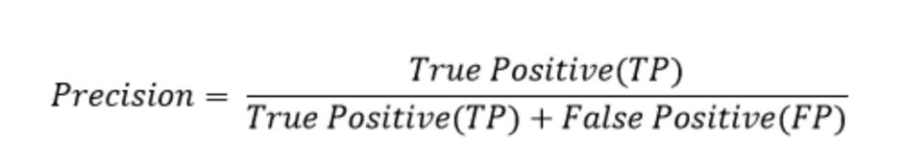
Precision
Precision is defined as the ratio of correctly classified positive samples (True Positive) to a total number of classified positive samples (either correctly or incorrectly).

Slide 17
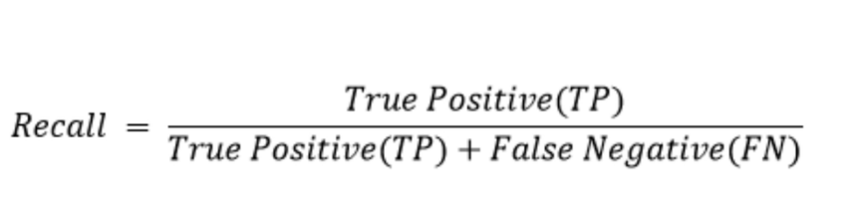
Recall
The recall is calculated as the ratio between the numbers of Positive samples correctly classified as Positive to the total number of Positive samples. The recall measures the model's ability to detect positive samples. The higher the recall, the more positive samples detected.

Slide 18
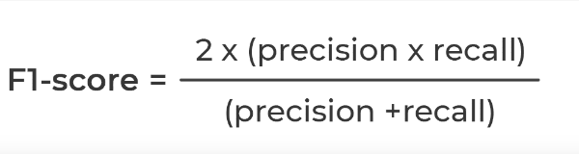
F1-score
The F1-score combines the precision and recall of a classifier into a single metric by taking their harmonic mean. It is primarily used to compare the performance of two classifiers.

Slide 19
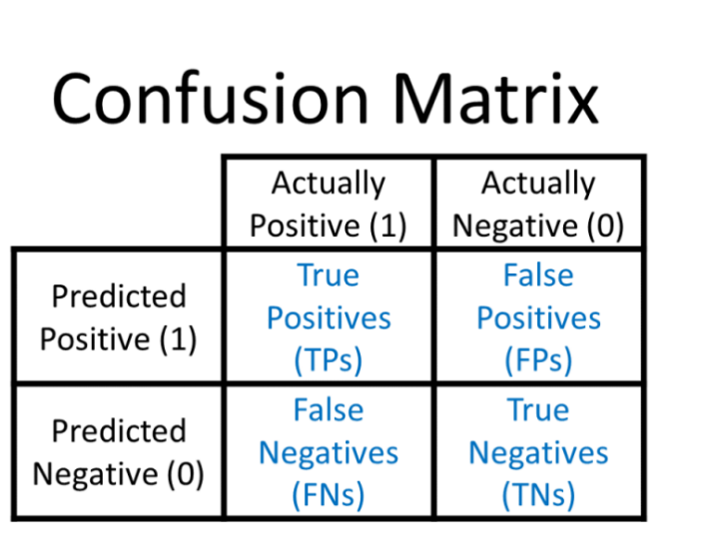
Confusion Matrix
The confusion matrix is a matrix used to determine the performance of the classification models for a given set of test data. It can only be determined if the true values for test data are known. The matrix itself can be easily understood, but the related terminologies may be confusing. Since it shows the errors in the model performance in the form of a matrix, hence also known as an error matrix. The matrix is divided into two dimensions, that are predicted values and actual values along with the total number of predictions. Predicted values are those values, which are predicted by the model, and actual values are the true values for the given observations.

Slide 20
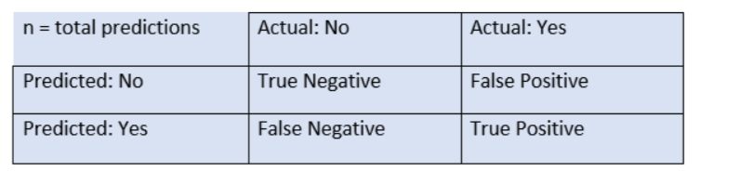
The above table has the following cases:
True Negative: Model has given prediction No, and the real or actual value was also No.
True Positive: The model has predicted yes, and the actual value was also true.
False Negative: The model has predicted no, but the actual value was Yes, it is also called as Type-II error.
False Positive: The model has predicted Yes, but the actual value was No. It is also called a Type-I error.

Slide 21
MODULES
The system consists of the following modules:
Loan Data Set
Data Visualization
1.Univariate analysis
2.Bivariate analysis
3.Multivariate analysis
Outlier treatment
Model building
1.Random Forest Classifier
2.Decision Tree Classifier
3.Logistic Regression

Slide 22
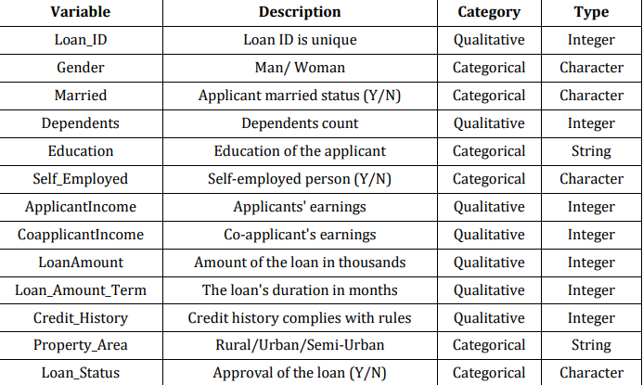
LOAN DATA SET
Loan Dataset is very useful in our system for prediction of more accurate result. Using the loan Dataset, the system will automatically predict which costumer’s loan it should approve and which to reject.

Slide 23
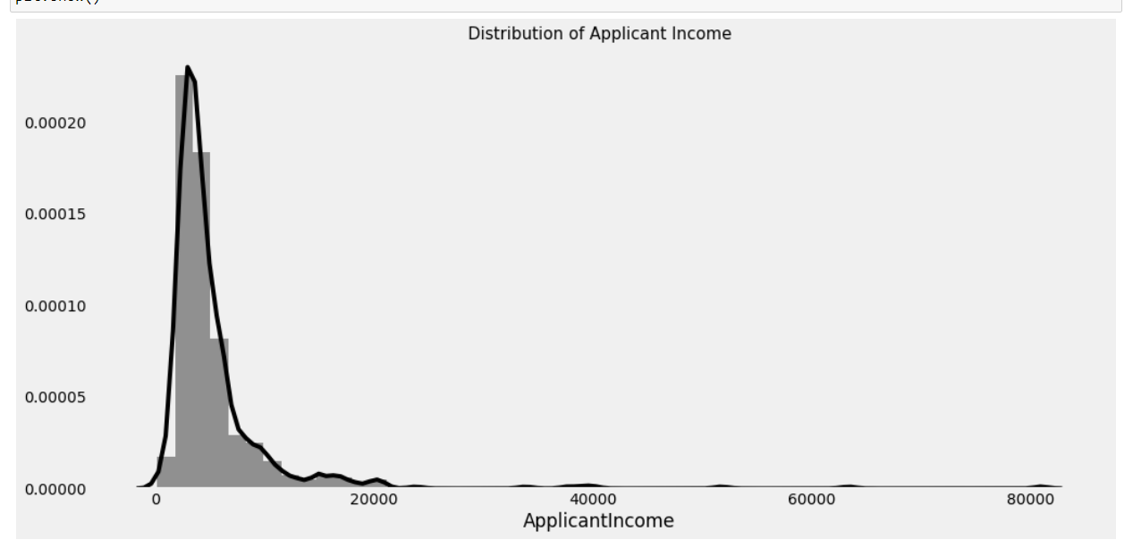
DATA VISUALIZATION
Data visualization refers to the representation of data and information in a graphical or pictorial form which involves the use of charts, graphs, maps, and other visual aids to communicate complex data and patterns in a concise and meaningful way

Slide 24
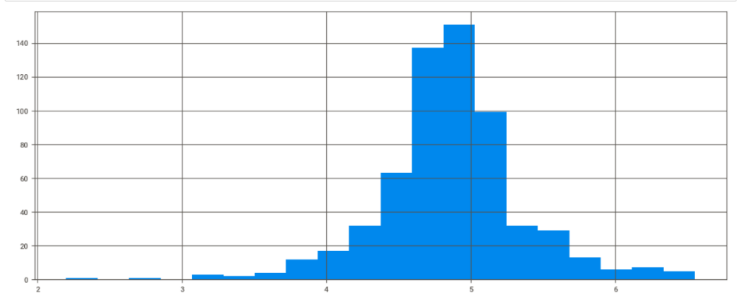
OUTLIER TREATMENT:
Outlier treatment helps the process of identifying and handling outliers in the training data to improve the accuracy and robustness of the model.

Slide 25
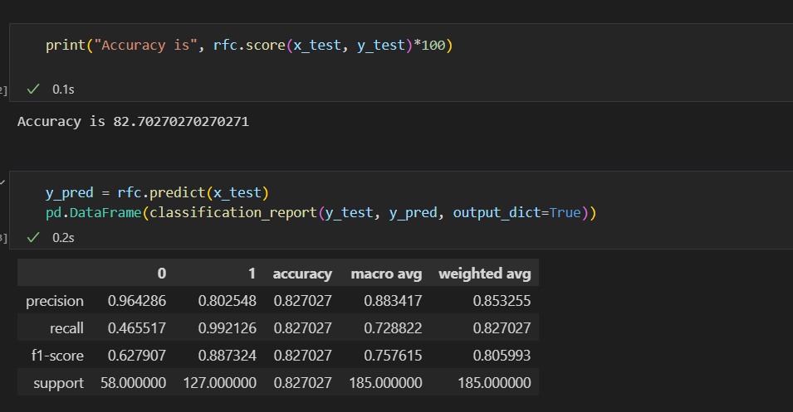
MODEL BUILDING
RANDOM FOREST CLASSIFIER: Random Forest is a tree-based bootstrapping algorithm wherein a certain no of weak learners (decision trees) are combined to make a powerful prediction model.

Slide 26
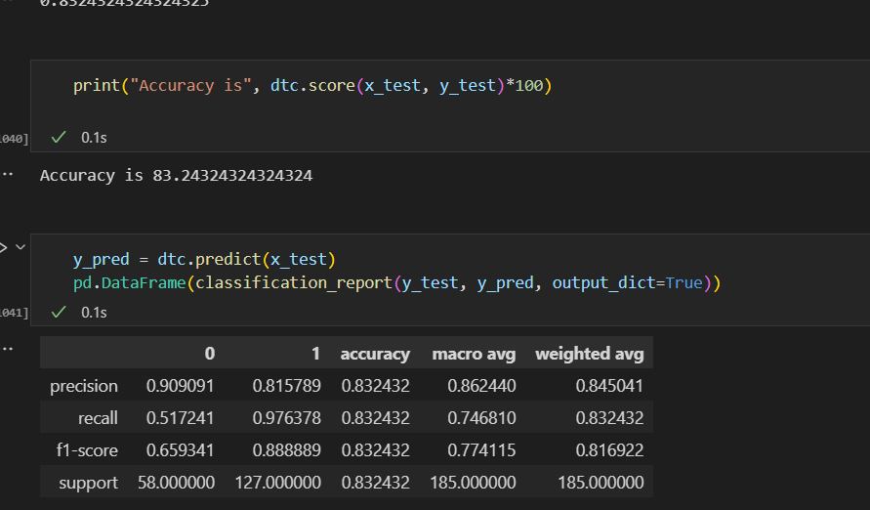
DECISION TREE CLASSIFIER:
Decision tree is a type of supervised learning algorithm that is mostly used in classification problems. In this technique, we split the population or sample into two or more homogeneous sets based on the most significant splitter in input variables.In other words, we can say that purity of the node increases with respect to the target variable.

Slide 27
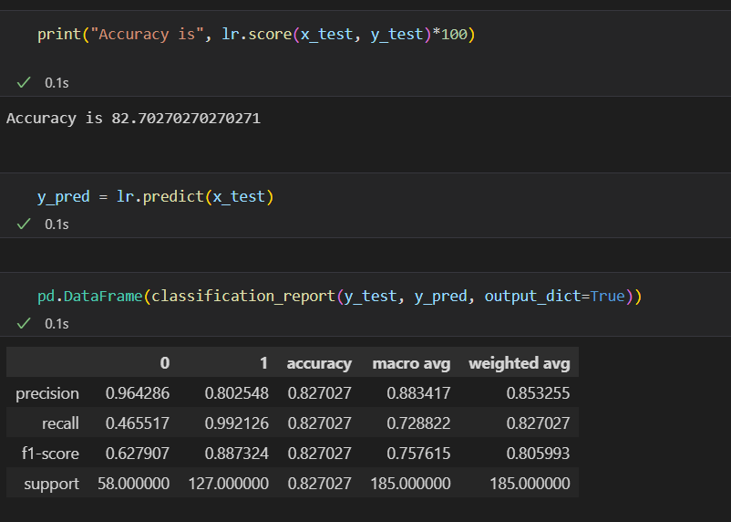
LOGISTIC REGRESSION
The Logistic Regression approach is a popular way to solve binary classification problems. Binary Logistic Regression makes use of binary dependent variables. The variables used should be relevant. Many of the model's independent variables should be self-contained. The sample size for LR should be large.

Slide 28
SAMPLE OUTPUT

Slide 29
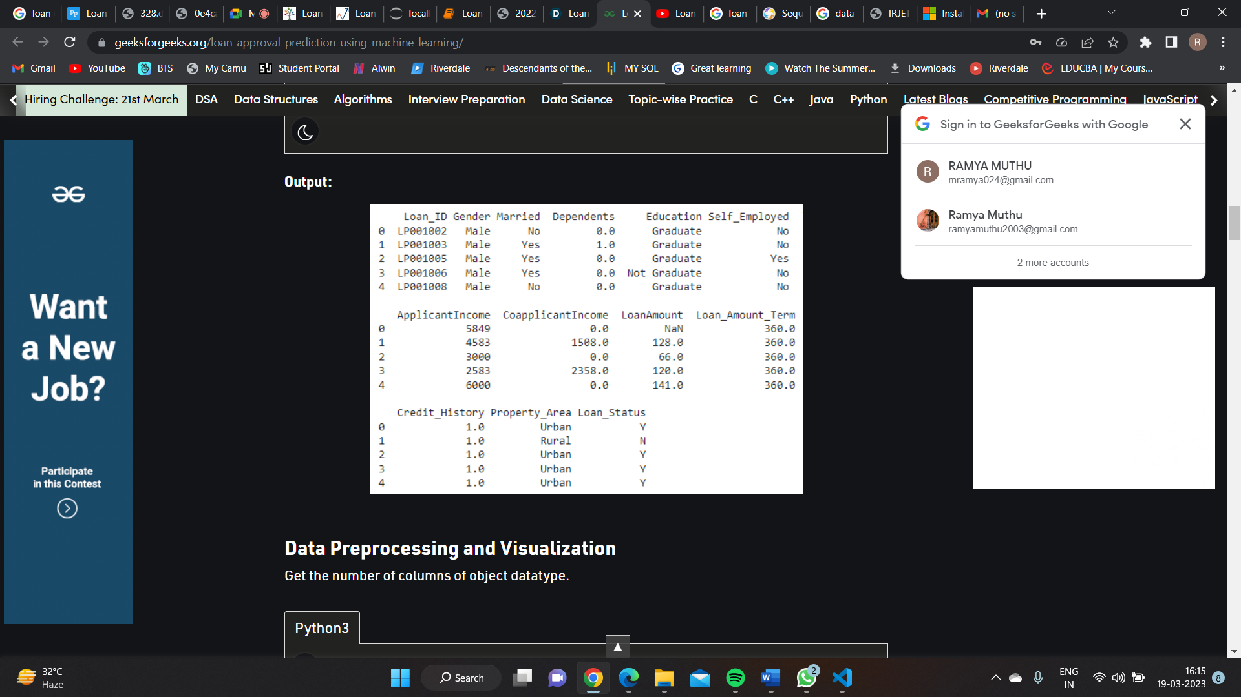
DATA VALUES OF LOAN SET

Slide 30
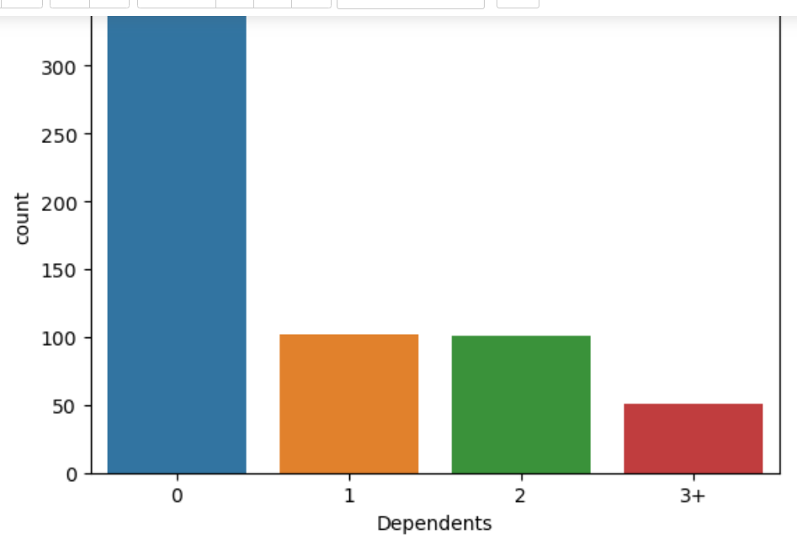
MULTIVARIANT ANALYSIS BETWEEN DEPENDENTS AND COUNT

Slide 31

LOGIN PAGE

Slide 32
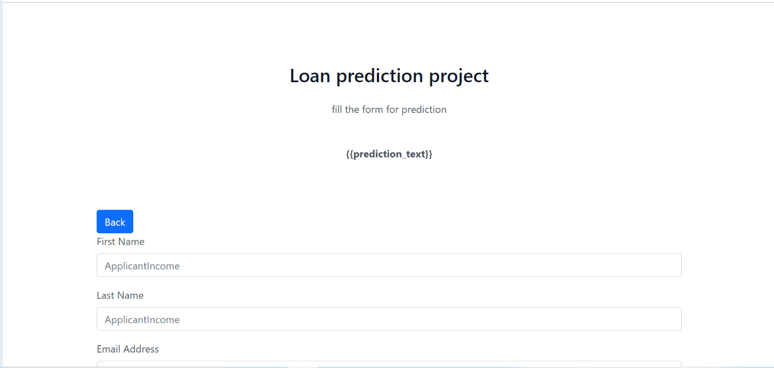
FORM TO BE FILLED

Slide 33
CONCLUSIONS
This system would be able to determine the status of the loan whether it would get approved or denied swiftly in real-time. We have compared the Logistic regression , Random Forest, and Decision tree . The Random Forest Classifier provided us with an accuracy of 81.57% while the Decision Tree method provided us with an accuracy of 83.48% and the Logistic regression has accuracy of 82.27%. However, of all the algorithms, Decision Tree has the highest accuracy.
ALGORITHMS | ACCURACY
RANDOM FOREST | 81.57%
DECISION TREE | 83.48%
LOGISTIC REGRESSION | 82.27%

Slide 34
FUTURE SCOPE
Parameters like Age, past health records, as well as the type of occupation they have will be utilized to evaluate the ambiguity factor of paying debts, and possible defaults of corporate loans for businesses and startups can be forecasted. Another method could be developed to forecast defaulters on different types of loans as well. We used a medium-sized data set to train our model, which may have influenced the outcome. Therefore, a big and well-defined data set is required for more accurate results.

Slide 35
THANK YOU

